Slide 1
軟體工程設計 W5
許庭瑋、陳君翰、洪世彬、劉玠均、楊昕叡、林俊佑
2023/10/19

Slide 2
Code Tracing

Slide 3
Weekly Code Tracing Progress
 | Part | LOC
spring-core-core
許庭瑋 | remaining part in io | 698
楊昕叡 | AnnotationTypeMapping.java | 568
劉玠均 | 13 collection converters in core/convert/support | 681
洪世彬 | org.springframework.core.env | 564
spring-core-aot, spring-core-cglib
陳君翰 | aot.hint (partial) | 404
林俊佑 | cglib.core (partial) | 600

Slide 4
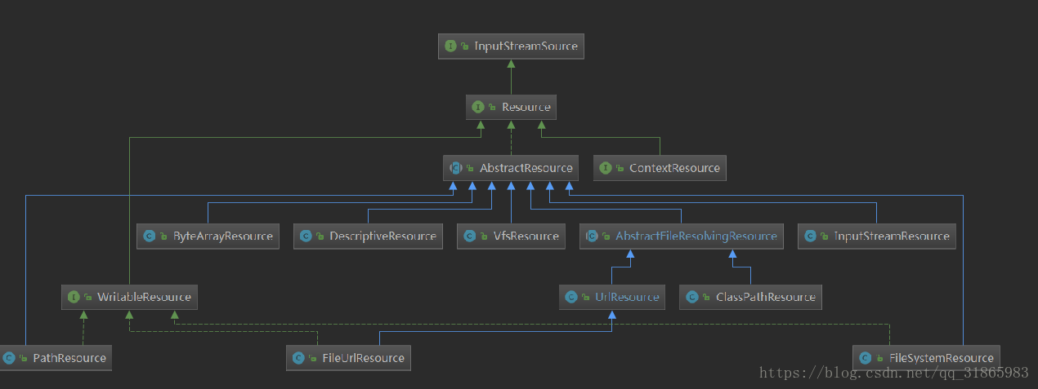
許庭瑋

Slide 5
許庭瑋
finish reading all files out of buffer/ and support/
FileSystemResource
get resource from java.io.File.
Use Files.newInputStream to get input stream, usually use api in java.io.File to implement functions
In all functions, check this.file first, then check this.filepath
FileURLResource
extends from URLresource, for urls like “file:...”, use java.io.File to read/write content
VfsResource and VfsUtils
For jboss vfs file, use method.invoke to use methods in jboss vfs
DescriptiveResource
Resource for description

Slide 6
許庭瑋
ModuleResource
Resource for Module, get stream by this.module.getResourceAsStream
PathResource
Resource for java.nio.file.Path.
functions and implements very like filepath operations in FileSystemResource
ResourceLoader
loading resources interface
DefaultResourceLoader
like classloader, has two main attributes: protocolResolvers and resourceCaches, to resolve path and create cache
FileSystemResourceLoader
extend DefaultResourceLoader, override method getResourceByPath
ProtocolResolver
protocol resolve interfece

Slide 7
楊昕叡
AnnotationTypeMapping
Store all @AliasFor relation between attribute methods in a map.
If there is a root attribute in a group of alias attributes, cover alias attributes with root attribute.
If exist, cover attributes with their root attributes.
If exist, cover attributes with source attributes with smaller distance to root.
MirrorSets(inner class of AnnotationTypeMapping)/MirrorSet(inner class of MirrorSets)
Use disjoint-set-like method to manage groups of attribute methods, where each group is aliases of each other.

Slide 8
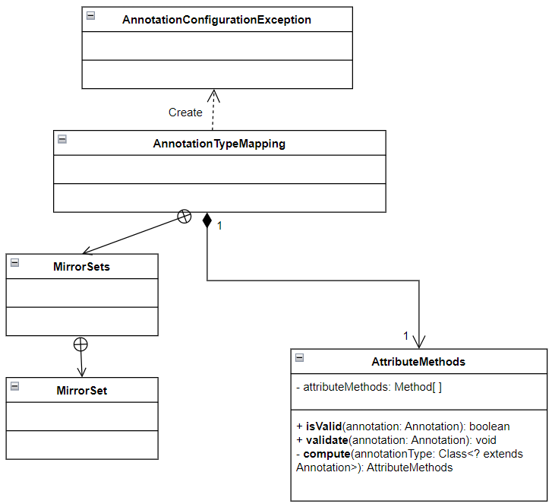
class diagram: full version
Inner classes often use attributes and methods defined in their parent class, parent class is composed of inner classes.

Slide 9
劉玠均
Converters (class diagram full version)
Default converters (W4)
Collection converters (W5)
Scalar converters, AbstractConditionalEnumConverter (W6)
Collection converters
Array/Collection/Object/String ToCollectionConverter
Array/Collection/Object/String ToArrayConverter
ObjectTo Collection/String Converter, StringTo Collection/String Converter
MapToMapConverter
StreamConverter
Notes:
ConvertingComparator<S, T>, DefaultConversionService, 8 default converters

Slide 10
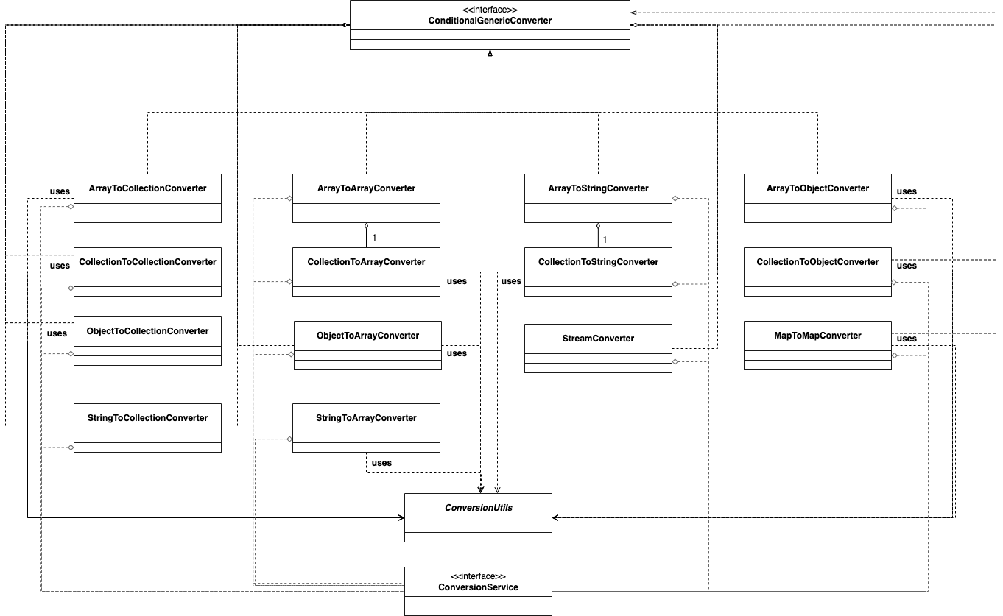

Slide 11
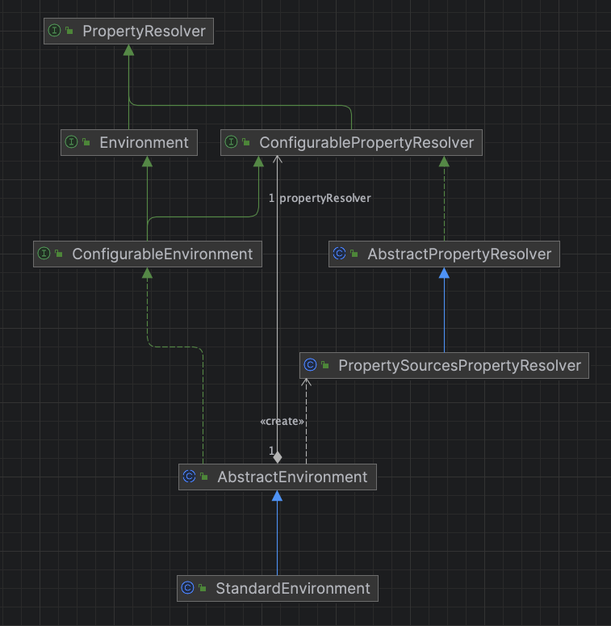
洪世彬
The primary function of the class diagram on the right side is to handle properties or configurations related to the Spring environment.

Slide 12
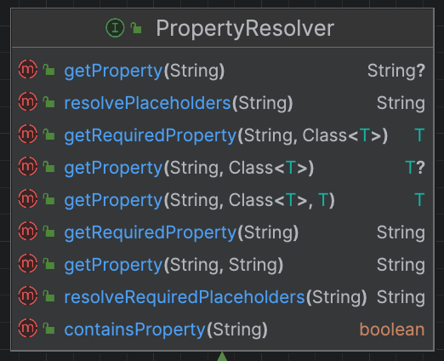
洪世彬
PropertyResolver defines an interface for querying properties and is implemented by PropertySourcesPropertyResolver.

Slide 13
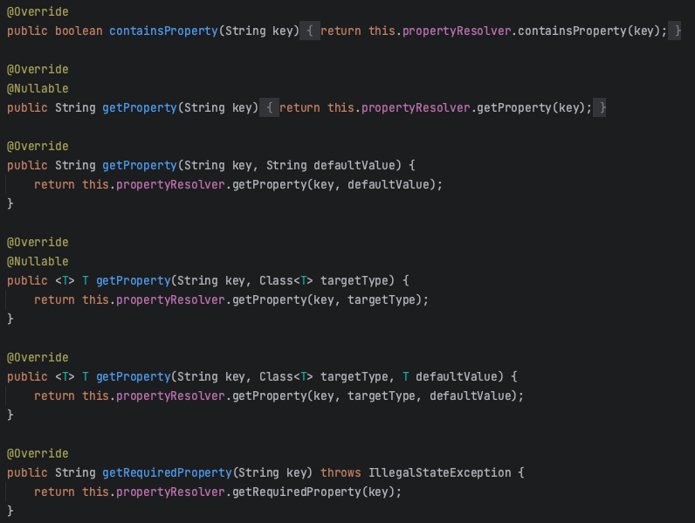
洪世彬
What's interesting is that both AbstractEnvironment and PropertySourcesPropertyResolver inherit from propertyResolver, but AbstractEnvironment doesn't actually implement the property querying methods; instead, it delegates this task to an instance of PropertySourcesPropertyResolver.

Slide 14
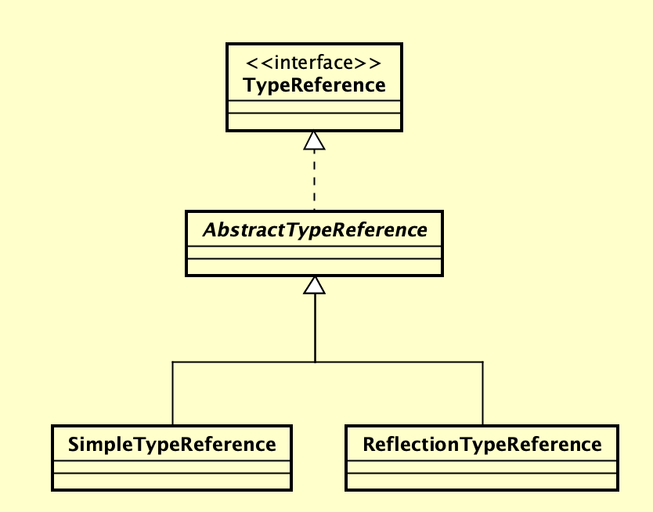
陳君翰
TypeReference (Interface)
Type abstraction that can be used to refer to types that are not available as a Class yet.
AbstractTypeReference (Abstract Class)
implementation of TypeReference.
make sure there is attribute of packageName, simpleName, enclosingName.
SimpleTypeReference
A TypeReference based on fully qualified name.
ReflectionTypeReference
A TypeReference based on a Class that exists.

Slide 15
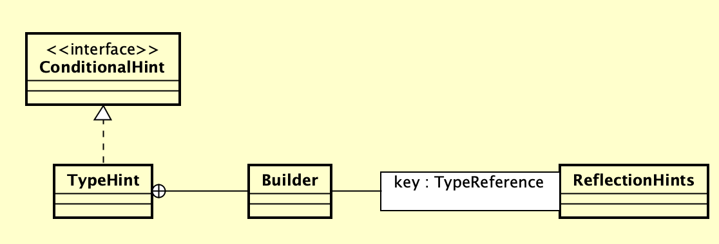
陳君翰
ReflectionHints
Gather the need for reflection at runtime.
TypeHint
A hint that describes the need for reflection on a type.
TypeHint$Builder
Builder for TypeHint

Slide 16
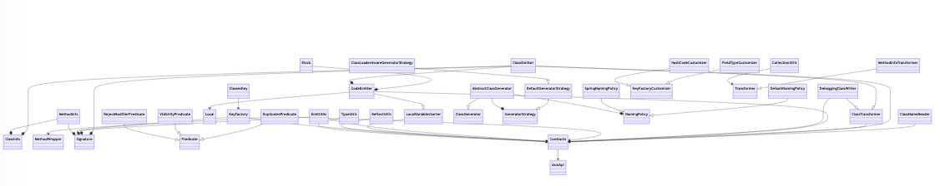
林俊佑
cglib.core
根據手繪的 UML, 推測主要入口在 ClassEmmiter, CollectionUtils, 下週主要從這兩個 class 怎麼被使用, 怎麼寫開始看

